Slide 1


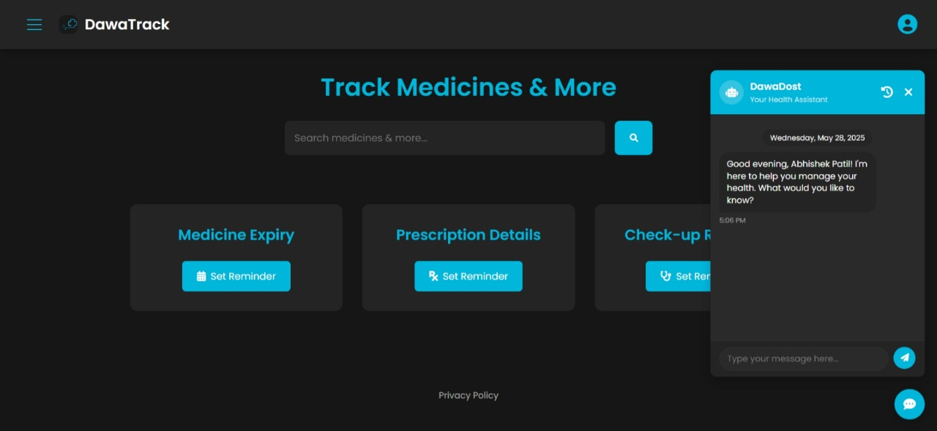
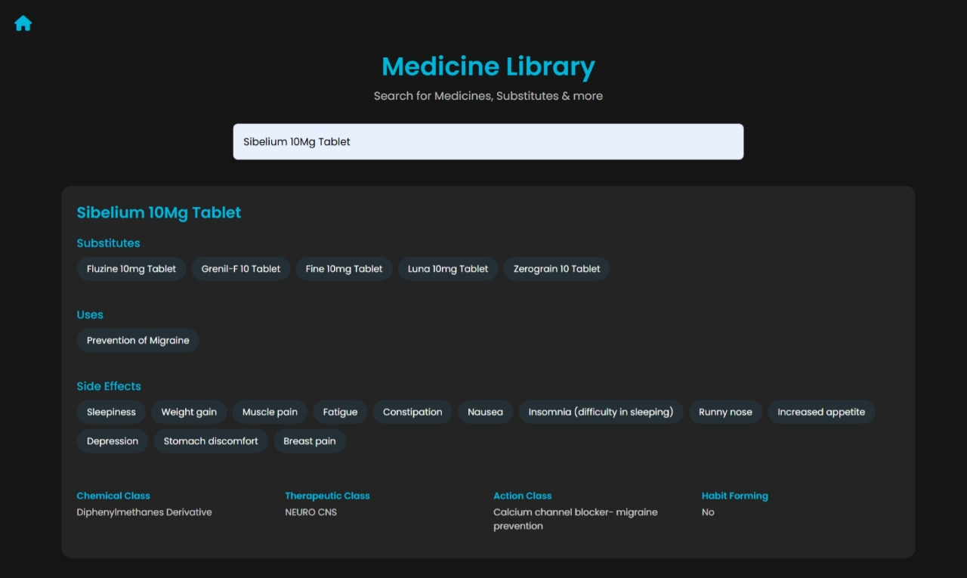
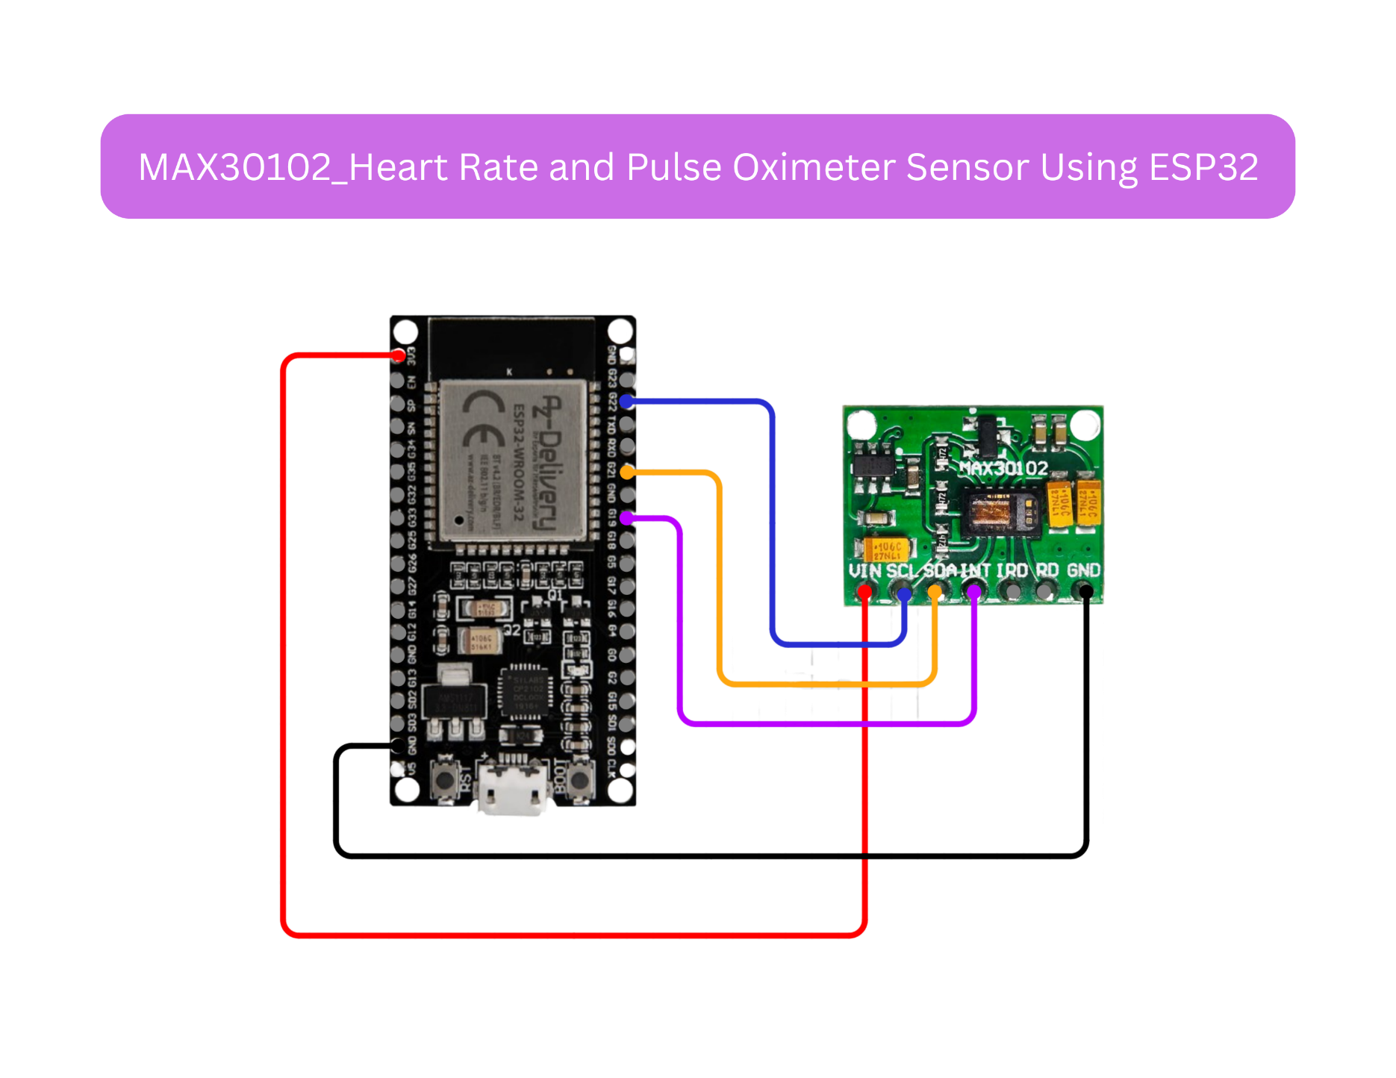
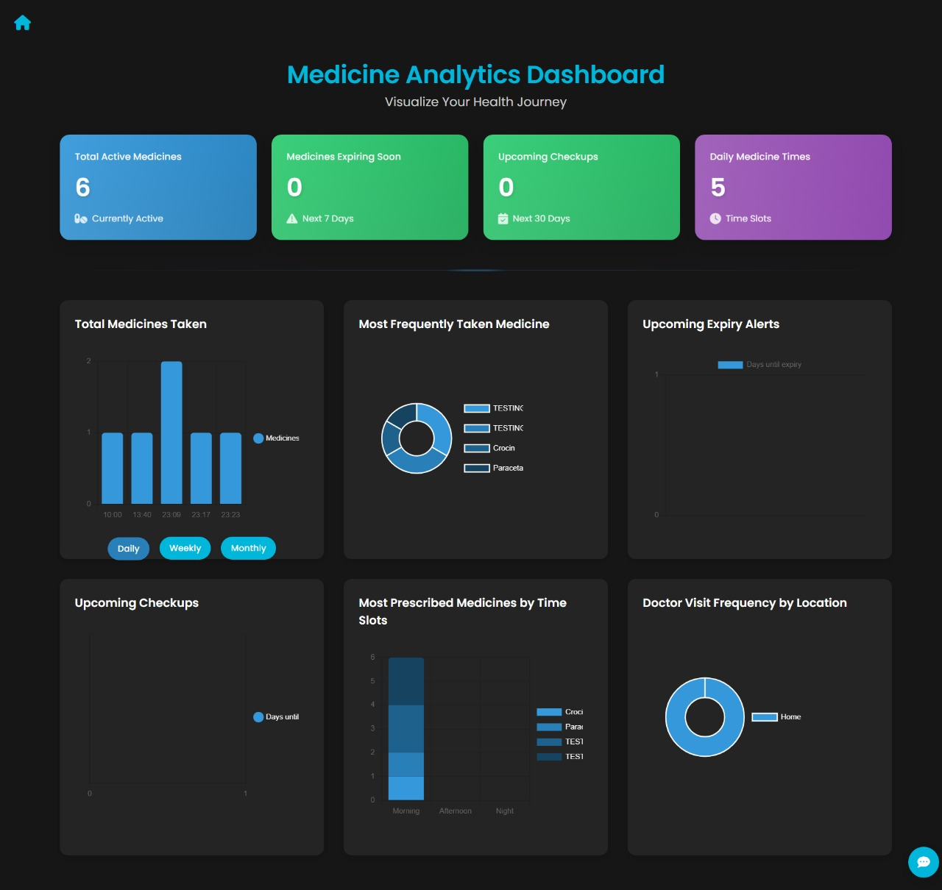
Dawatrack – your personal medical guardian
ASE Project 2 Guide Pooja Wanjale, Aditi Patil, Abhishek Patil, Adit Pakhode,
Abhinandan Bardia, Pradyumna Adhari, Abhishek Singh
Department of Engineering Science and Humanities (DESH)
Vishwakarma Institute of Technology, Bibwewadi , Pune
Students’ Conference on Applied Science & Engineering Projects - JUNE 2025
ASEP2
GROUP NO.
CSAIML- A2
ABSTRACT
IMAGES
DawaTrack is a digital health solution designed to improve medication compliance.
Tracks expiry dates, sends email reminders, and integrates with the Google Calendar API for seamless scheduling.
Securely stores prescriptions and medical data using Supabase with its SQL editor backend.
Designed with a clean and responsive frontend using HTML, CSS, and JavaScript.
Features include checkup reminders, secure prescription storage, and real-time vitals monitoring (heart rate and SpO₂) using ESP32 sensors.
A hamburger menu offers quick access to ChatBot, Reminder Calendar, My Medicines, Medicine Library, and Health Tips.
IMAGE 1: ChatBot
INTRODUCTION
IMAGE 2 : Medicine Library
Medication non-compliance leads to health risks like worsened conditions and hospitalizations.
Manual tracking and paper prescriptions are error-prone and inefficient.
DawaTrack offers a digital solution with email reminders, expiry tracking, and secure prescription storage.
Aims to reduce medication wastage and improve treatment outcomes.
Bridges the gap between traditional medication management and modern healthcare technology.
Includes real-time heart rate and SpO₂ monitoring using ESP32 microcontroller and sensors, promoting holistic health tracking.
A user-friendly hamburger menu provides easy access to Reminder Calendar, My Medicines, Medicine Library, and Health Tips.
HARDWARE INTEGRATION
IMAGE 3 : Statistics
NOVELTY FEATURES / FINDINGS
Email Reminders: Timely notifications for medication and checkups
Expiry Tracking: Alerts users about expired medications to ensure safety.
Prescription Storage: Safely stores and organizes prescriptions electronically using Supabase.
Checkup Reminders: Syncs appointments via Google Calender.
Vitals Monitoring : Tracks heart rate and SPO2 using ESP32 sensors
User-Friendly Interface: Designed with HTML, CSS, and JavaScript for ease of use..
Hamburger menu: Quick access to Calender , Medicines library and Heath Tips.
RESULTS AND DISCUSSIONS
85% of users reported improved medication compliance.
40% reduction in expired medication usage due to expiry tracking.
78% of users found prescription storage highly useful.
Checkup reminders were added to ensure timely medical appointments.
Users appreciated the email reminders and secure storage features.
Demonstrated potential to reduce hospital visits and improve healthcare efficiency.
CONCLUSIONS
TESTING / IMPLEMENTATION
DawaTrack effectively addresses medication non-compliance and improves adherence.
Reduces medication wastage and enhances patient safety.
Email reminders and secure storage make it accessible and user-friendly.
Checkup reminders ensure holistic healthcare management.
Future developments include voice alerts, wearable integration, and advanced analytics.
A scalable solution for improving healthcare outcomes through digital innovation.
Unit Testing done for reminders, expiry tracking, and calender sync.
Integration Testing ensured smooth frontend-backend Interaction.
ESP32 Sensors tested for accurate heart rate and SpO2 data.
UI/UX Testing focused on responsiveness and menu navigation.
Google Calender API tested for event Creation and sync.
User feedback collected to fix bugs and inprovs usability.
Performance Testing ensured fast load times and smooth functionalbility

